Slide 1
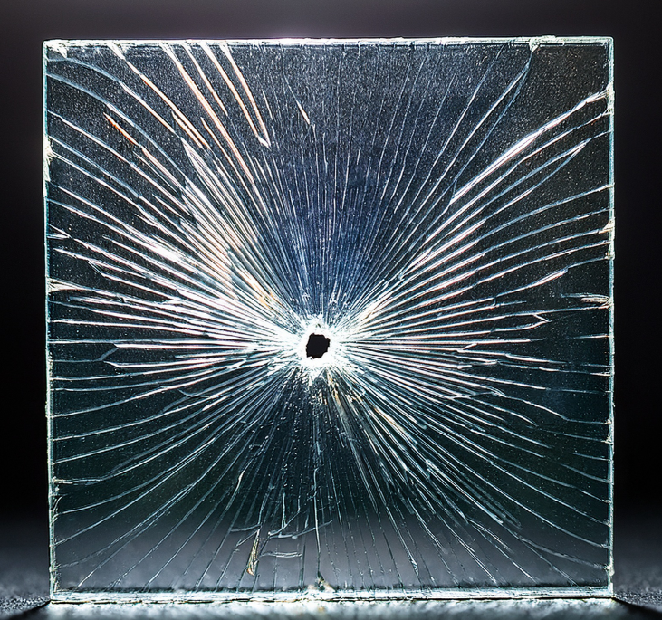
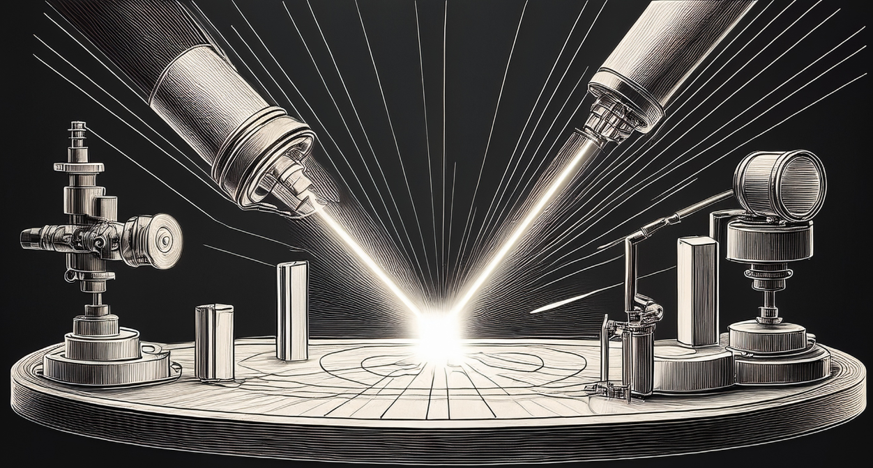
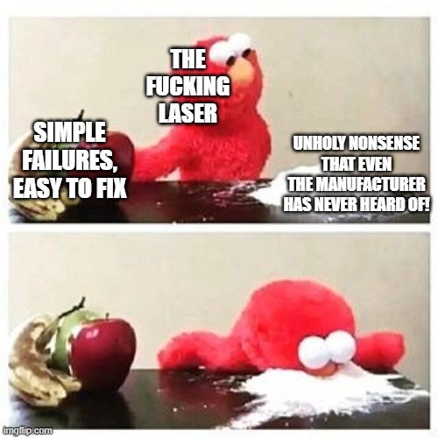
MY PHD TOPIC
Your Name¹, Your Supervisor^{1,2}, Your Working Group¹
¹ Institute of Applied Physics, Abbe Centre of Photonics, Friedrich Schiller University Jena, Albert-Einstein-Str. 15, 07745 Jena, Germany
² Fraunhofer Institute of Applied Optics and Precision Engineering, Albert-Einstein-Str. 7, 07745 Jena, Germany
Abstract
  cmon… you know how to write an abstract
  use this as a conversation starter
Research Topic
  give the most necessary information about your topic
  include some reasons for why your research is done and give some possible applications
  keep it simple for people outside of your field of research
  a sketch/diagram is very helpful
  keep in mind: you are standing in front of the poster most of the time. all detailed information can be explained by you, while talking to interested people
Experimental results
  short introduction into your experimental setup
  a sketch is probably very helpful here
  show possible results of your work
  no need for super polished results, this is no high level conference contribution!
Fig.1: Laser goes BOOM.
Fig.2: Glas sample after laser went BOOM.
Challenges during your work
  list challenges you had to overcome during your PHD work so far
  this can help to find people who have the same problems/challenges
  discuss possible solutions of other people
  nobody is an expert for everything, maybe someone can help you with their expertise in topics which are problematic for you
  potential large topics are:
    coding
    simulations
    specific material/sample characterization
    availability for special light sources
  also include not directly scientific problems:
    teaching assistance
    administrative struggles
Outlook
  next steps in your PHD work
  future problems?
  give potential topics for cooperations
References
  [1]: Theodore. H. Maiman, Nature, 187.4736 (1960).
  [2]: Boyd, R. W., Nonlinear optics (4th ed.), Academic Press (2020).
Your Name
Your Name@uni-jena.de
Acknowledgement: This research is funded by a lot of coffee. I am very grateful to my flexible sleep schedule for supporting all the long nights of working.

